Slide 1



www.ziaossalehin.ir

Slide 2


Slide 3


Slide 4

www.ziaossalehin.ir

Slide 5

www.ziaossalehin.ir

Slide 6


Slide 7
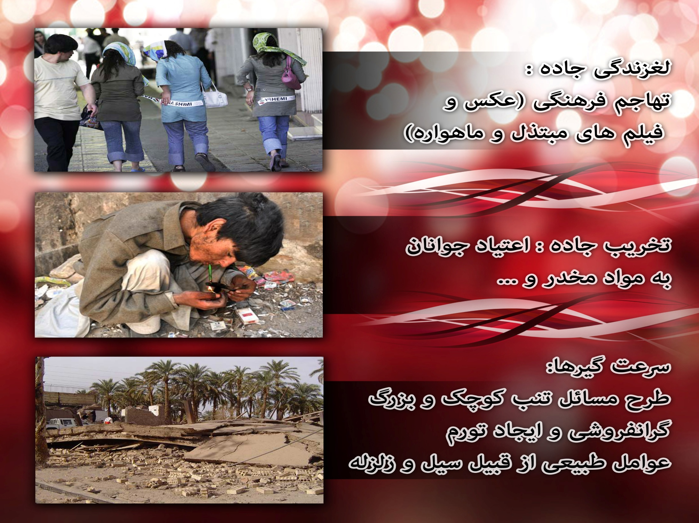

Slide 8


Slide 9
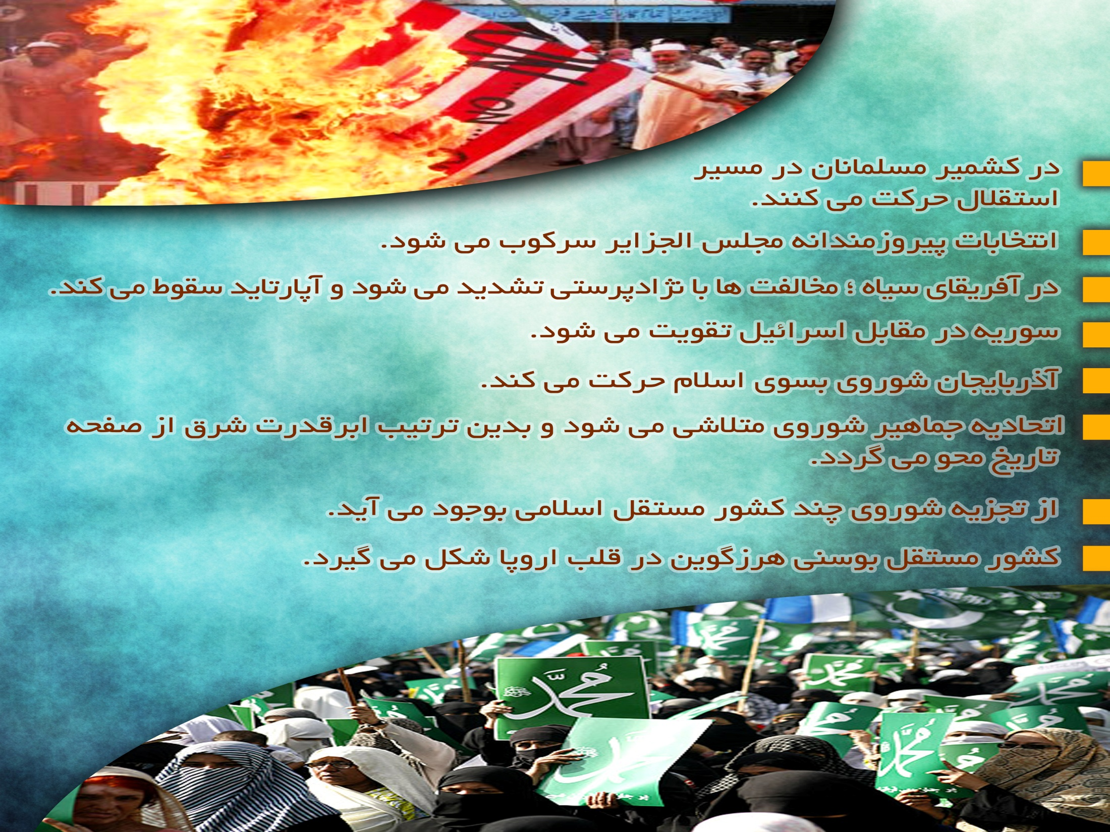

Slide 10
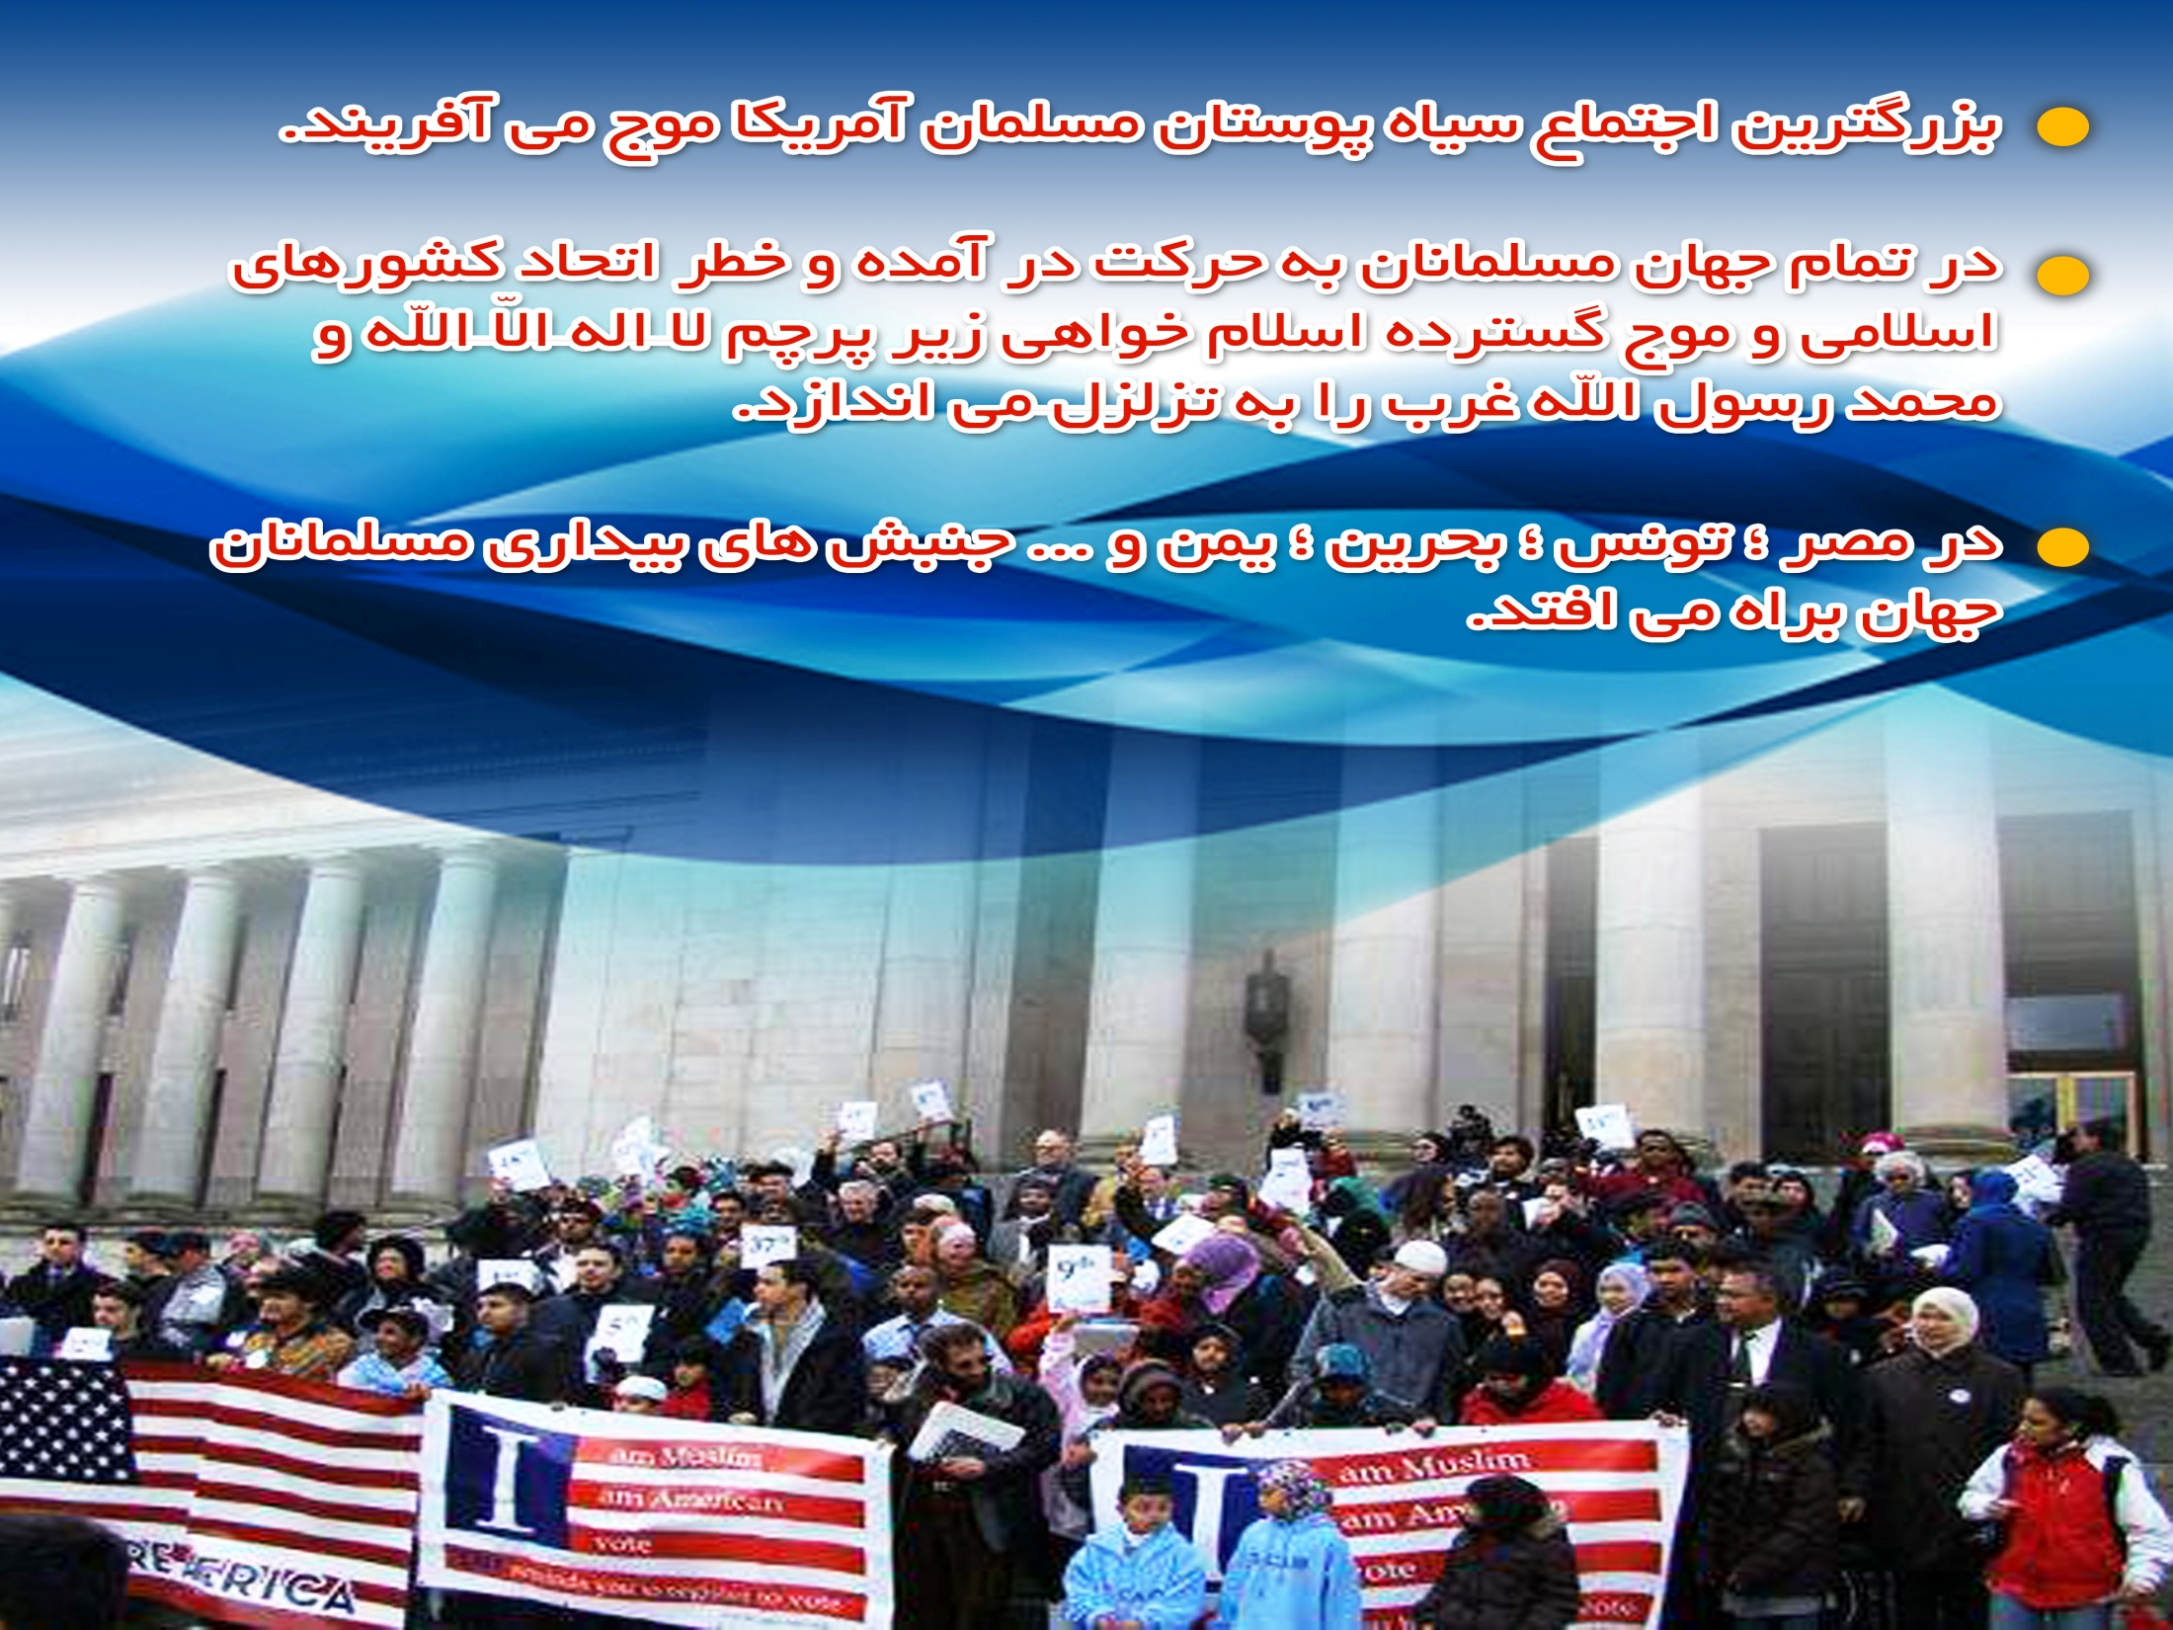

Slide 11

www.ziaossalehin.ir

Slide 12

www.ziaossalehin.ir

Slide 13
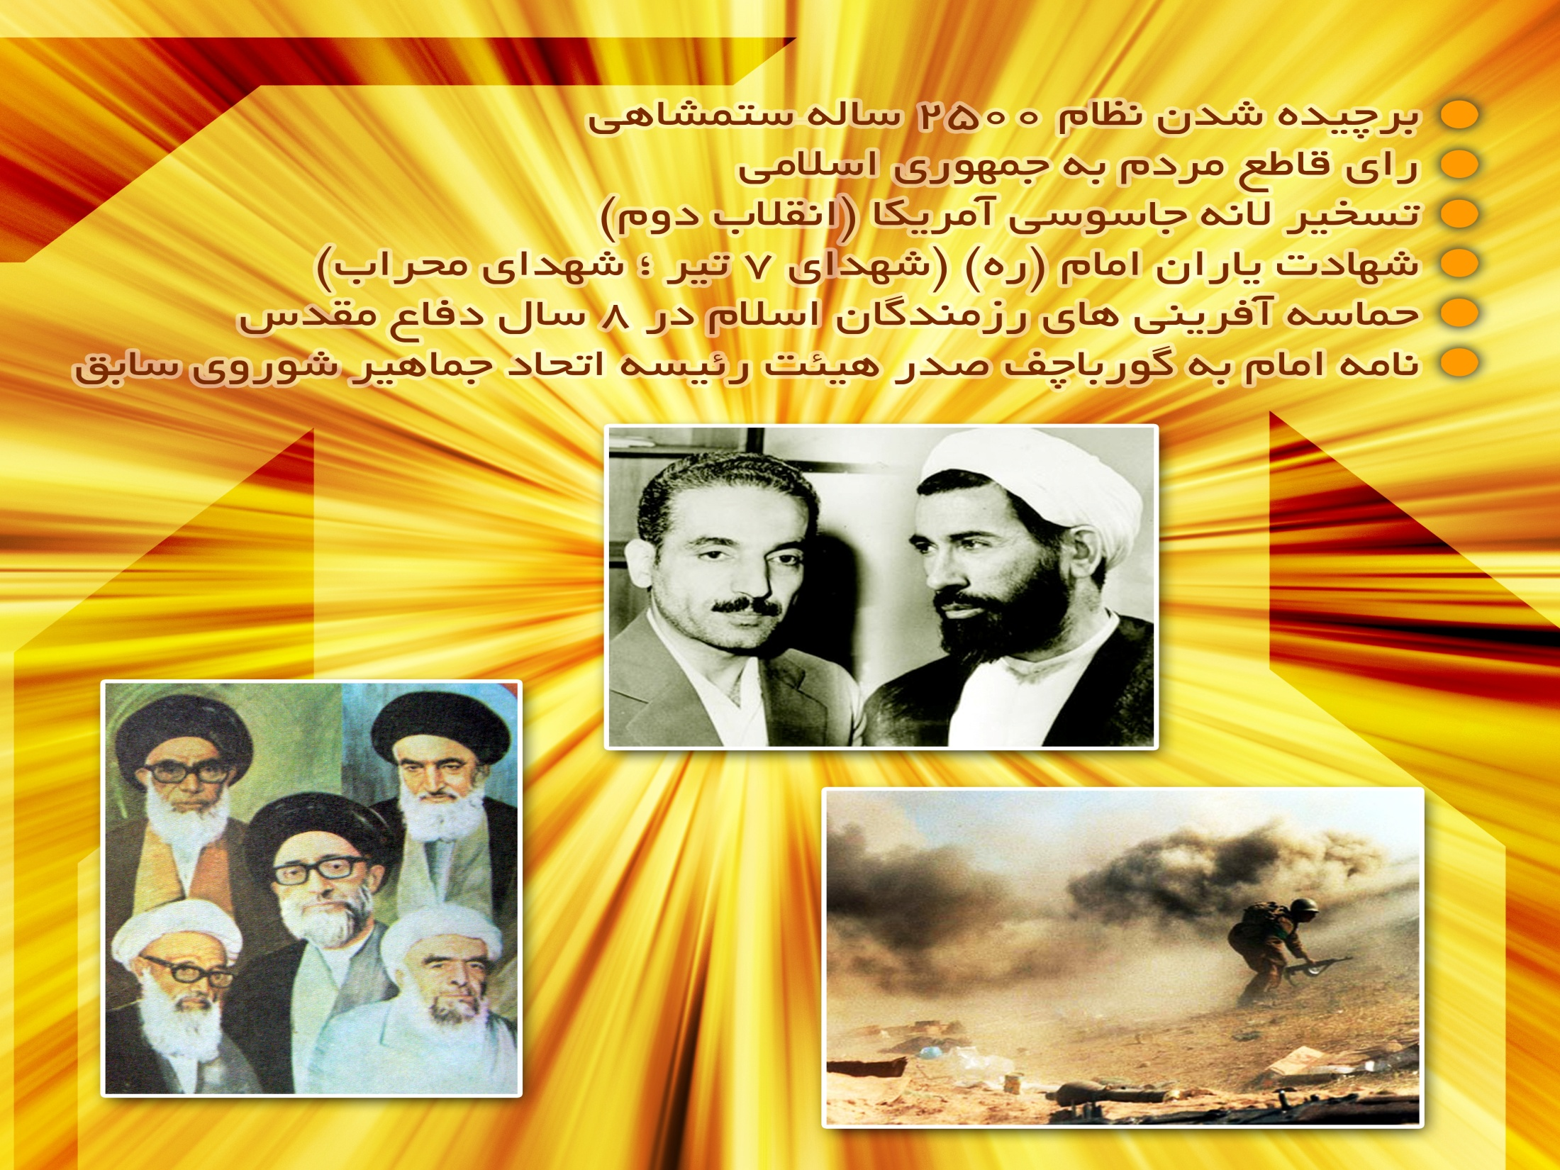

Slide 14
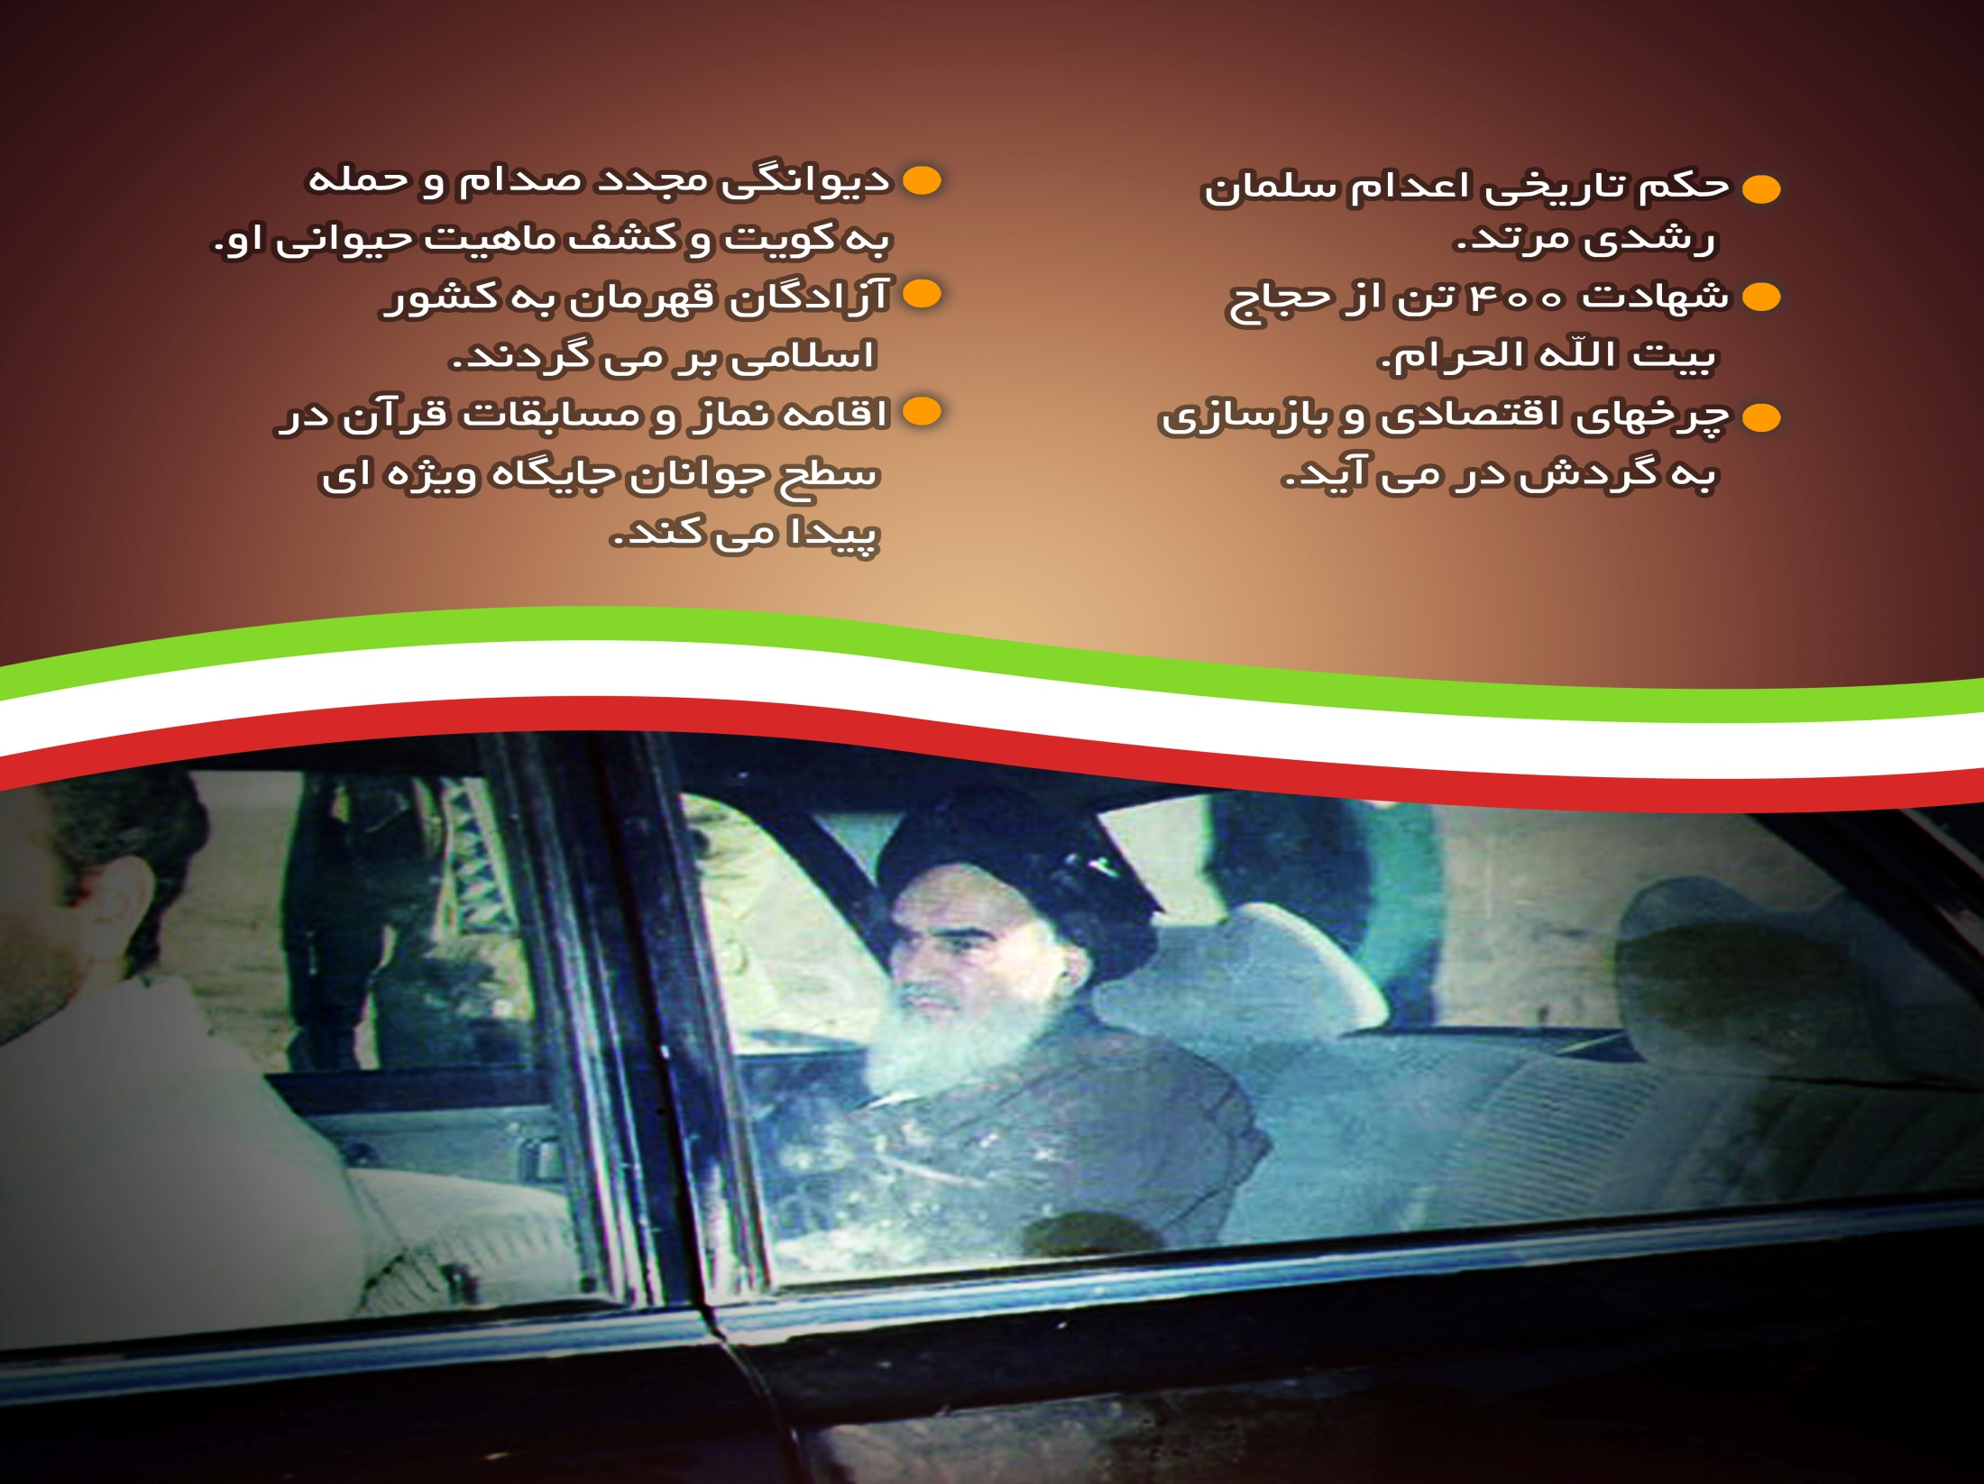
www.ziaossalehin.ir

Slide 15
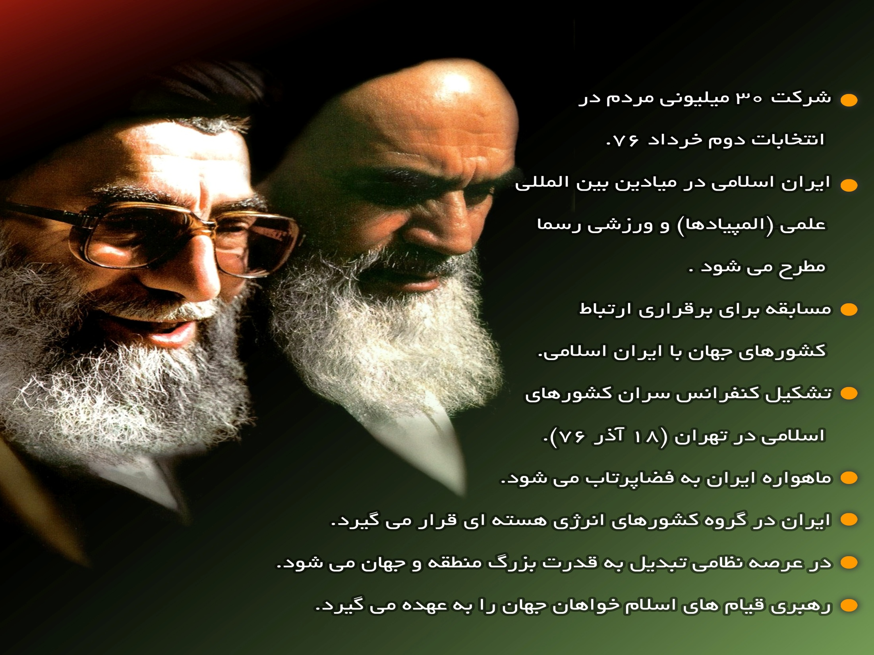
www.ziaossalehin.ir

